Slide 1
DAMG 6105 - Data Science Engineering with Python
Prof. Handan Liu
- Team 3
Nikhil Choudhari
Pratik Kanade

Slide 2
Introduction to Data
Dataset - Amazon for Adults (Melatonin)
Dosages - 1, 3, 5, 10, 12, 20 mg
Total rows - 41251
Total variables (Columns) - 15
Distinct Brands - 5 (Natrol, Carlyle, Nature’s Truth, Olly, Nature’s Perfect Night )
Important Columns - ReviewContent, ReviewDate, ReviewScore, ProductTitle

Slide 3
A glimpse of data preprocessing
Unimportant columns such as ASIN, Product URL, Images, Reviewer were dropped as these columns were not useful to the analysis
The dosage of the melatonin supplement was extracted from the Product Title
Rows with NA values in ReviewContent were dropped
ReviewMonth extracted from ReviewDate

Slide 4
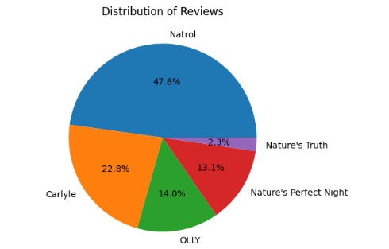
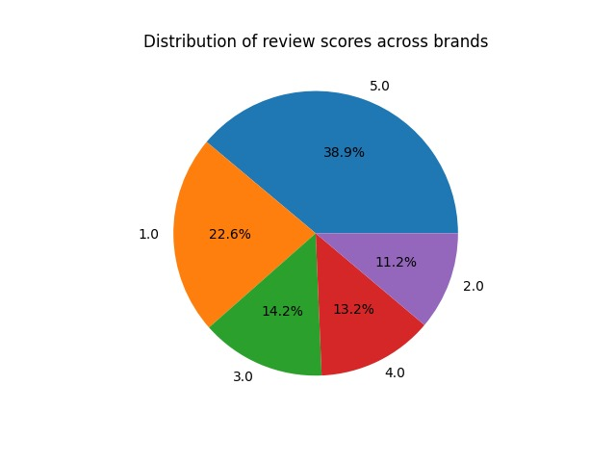
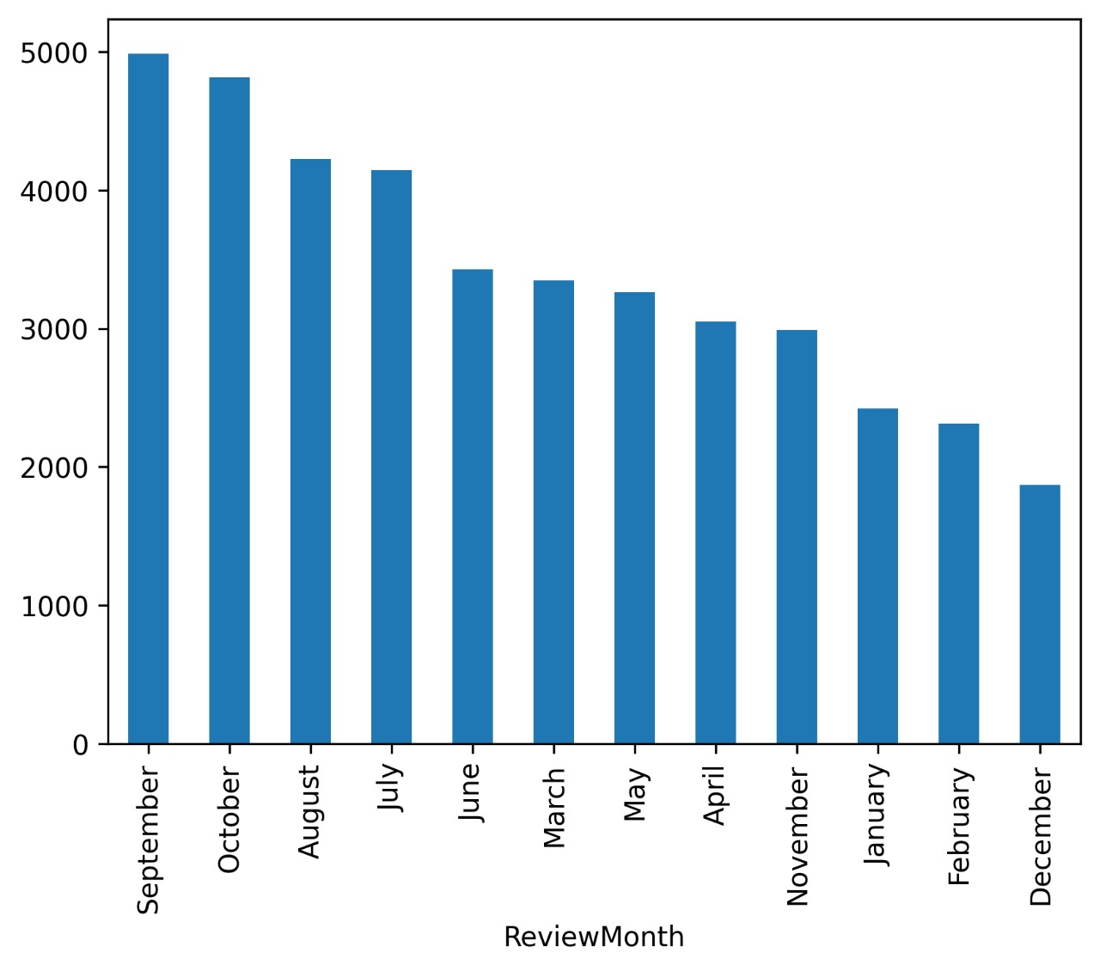
Natrol has most number of reviews
Most reviews are made in the month of september on average every year. Where as least number of reviews are written in December

Slide 5
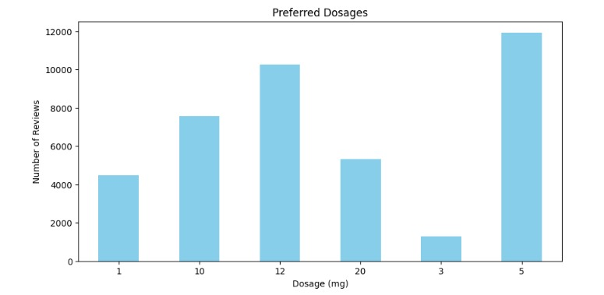
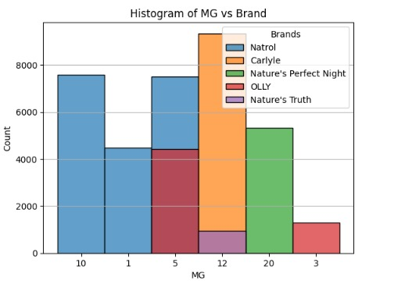
5 mg is the most popular choice of dose when choosing between the various dosages
3 mg is the least chosen
When it comes to choosing a brand to use 10 mg dose, the most preferred brand is Natrol
Whereas when choosing 20 mg dose, Nature’s Perfect Night is the most sought after

Slide 6
NLP Data Processing
Converted all the reviews to lower case
Removed the punctuations from the reviews
Tokenized the reviews to get list of tokens
Removed the words that are present in the stop word corpus
Used PorterStemmer() for stemming : easily converted to easi
Used WordNetLemmatizer() for lemmatization : easily converted to easy
Joined the tokens to get cleaned reviews
Used TF IDF Vectorization to create a Logistic Regression Model

Slide 7
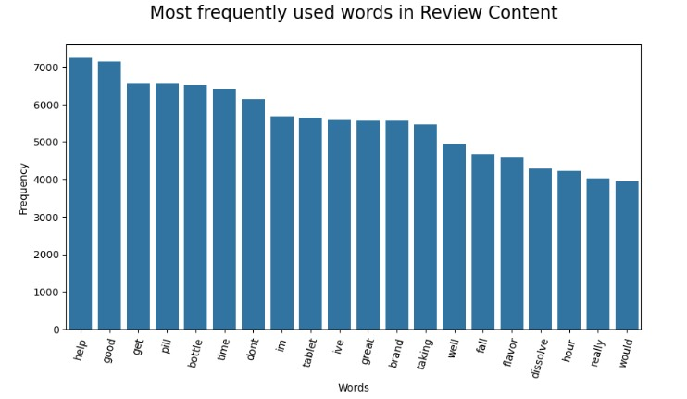
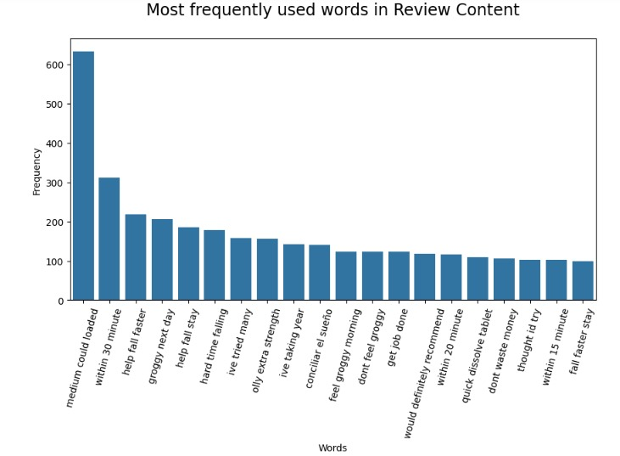
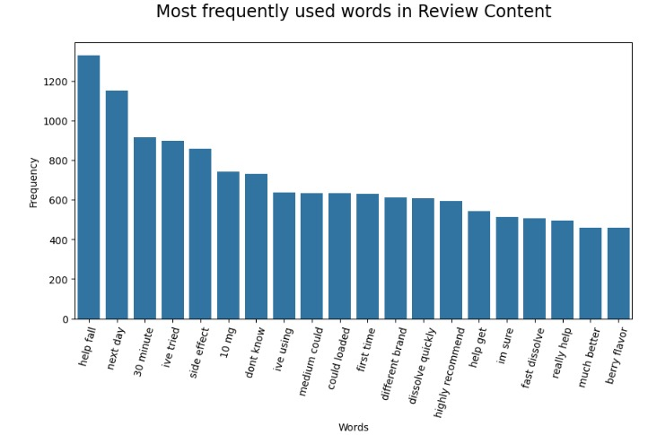
N-grams

Slide 8
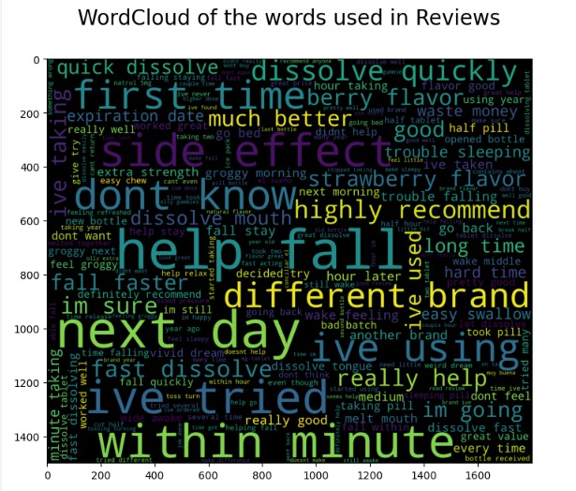
Word Cloud

Slide 9
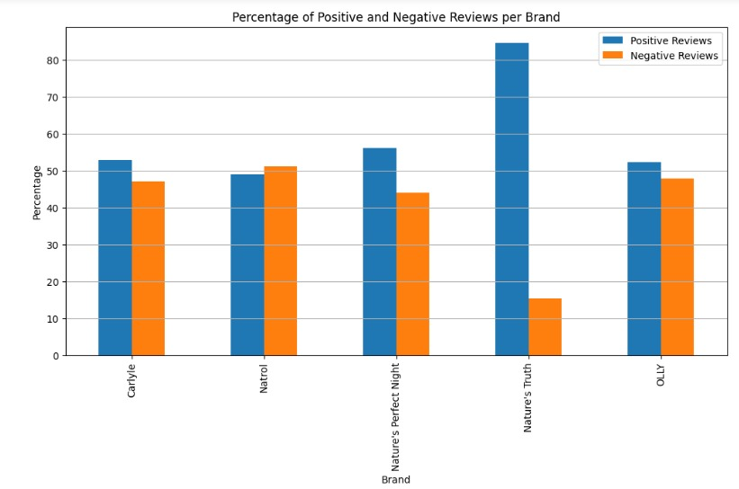
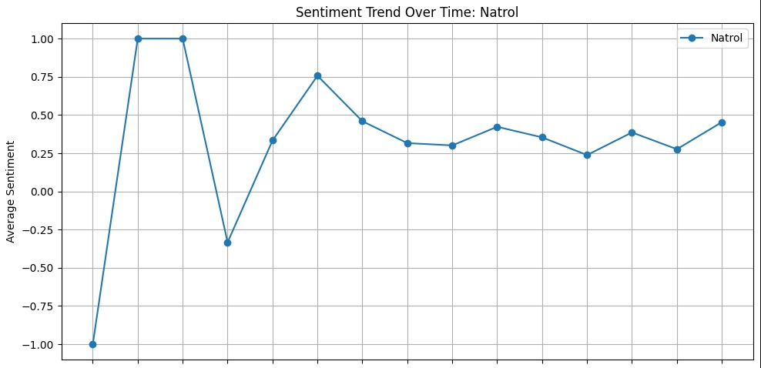
Interesting Findings
Nature’s Truth is the most loved Brand as it has the least negative reviews Natrol is the least liked
Although Natrol has most negative reviews, its sentiment has been changing from the -1 to being neutral to positive.

Slide 10
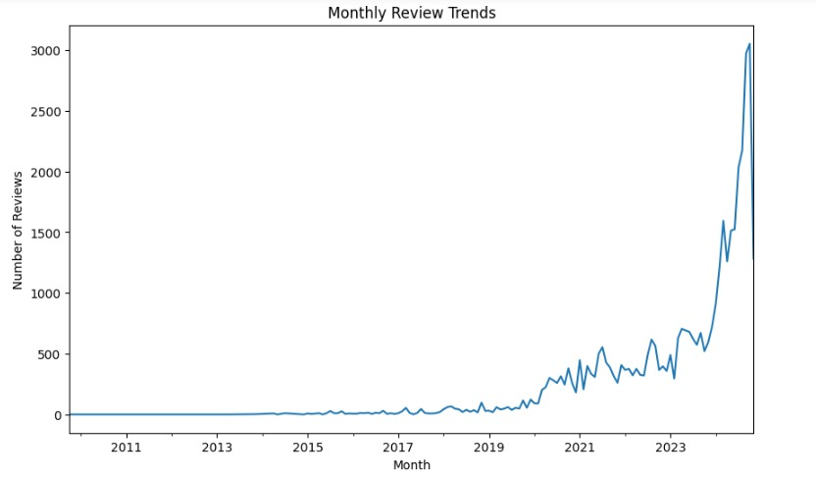
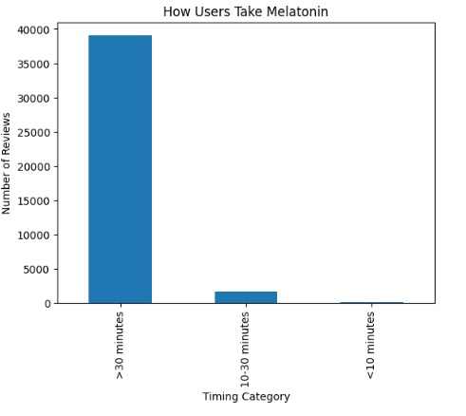
Customers have started to give more reviews in recent times.
Most preferred time to take the melatonin supplement is 30 mins before bed.

Slide 11
Individual Contributions
Nikhil Choudhari
Data Preprocessing
Exploratory Data Analysis
Univariate, Bivariate Analysis
Distribution of the ratings for each dosage
Average rating over dosage
Analysed melatonin intake by users
Checked the sentiment over the time
Number of reviews trend over time
What dosage people prefer
TF-IDF vectorization and regression
Pratik Kanade
Loading the dataset
Data Preprocessing
NLP Data cleaning
Frequency of words
Formed N Grams
Formed Word Cloud
Performed Sentiment Analysis
Checked sentiment of each dosage
The intensity of user emotions: statistics and analytical adjectives

